Slide 1
Dependence Analysis (CS 3006)
Dr. Muhammad Aleem,
Department of Computer Science,
National University of Computer & Emerging Sciences, Islamabad Campus

Slide 2
The Big Picture
What are our goals?
Simple Goal: Make execution time as small as possible
Which leads to:
Achieve execution of many (all, in the best case) instructions in parallel
But, you have to find INDEPENDENT instructions

Slide 3

Data Dependence
Data must be produced and consumed in the correct order
Simple example of data dependence:
Statement S3 cannot be moved before either S1 or S2 without compromising correct results

Slide 4
Motivation
DOALL loops: loops whose iterations can execute in parallel
for i = 11, 20
a[i] = a[i] + 3

Slide 5
Examples
for i = 11, 20
a[i] = a[i] + 3
Parallel
for i = 11, 20
a[i] = a[i-1] + 3
NOT Parallel?
for i = 11, 20
a[i] = a[i-10] + 3
Parallel ?
Notes:
A(11) = A(1) + 3
A(12) = A(2) + 3
A(13) = A(2) + 3
A(14) = A(3) + 3
A(15) = A(4) + 3
.
.
.
A(20) = A(10) + 3, NO Dependence → Parallelizable

Slide 6
Dependence Analysis
A dependence is a relationship between 2 computations that places constraints on their execution order
Dependence analysis identifies these constraints
Constraints are used to determine whether a particular transformation can be applied without changing the computation’s semantics
2 types of dependences: control and data dependences
Both of them must be considered when parallelizing programs.

Slide 7
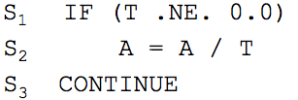
Control Dependence
There is a control dependence between S1 and S2, when S1 determines whether S2 will be executed or not
Example:
Executing S2 before S1 could cause a divide by zero exception (in this example).
S2 is conditional upon the execution of the branch in S1.

Slide 8
Data Dependence
Two statements have a data dependence if they cannot be executed simultaneously due to conflicting uses of the same data.
Ensure that data is produced and consumed in the right order:
do not interchange loads and stores to the same location
two stores take place in the correct order
Formally:
There is a data dependence from statement S1 to statement S2 (S2 depends on S1) if:
Both statements access the same memory location and at least one of them stores onto it, and
There is a feasible run-time execution path from S1 to S2

Slide 9
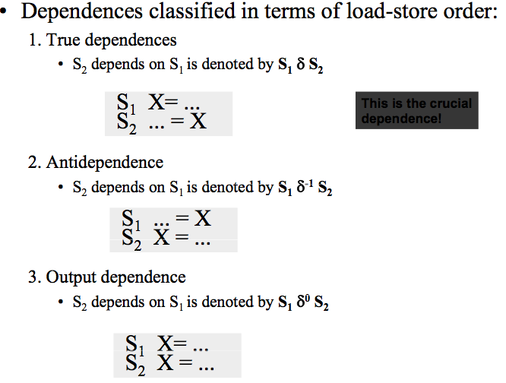
Load/Store Classification
This is a crucial dependence!

Slide 10
Data Dependence of Scalar Variables
True/Flow dependence
Anti-dependence
Output dependence
Input dependence
a =
= a
a =
a =
= a
a =
= a
= a
Only data flow dependences are true dependences.
Anti and output can be removed by renaming

Slide 11
Array Accesses in a Loop
for i= 2, 5
a[i] = a[i] + 3
a[2]
a[3]
a[4]
a[5]
read
a[2]
a[3]
a[4]
a[5]
write

Slide 12
Array Anti-dependence
for i= 2, 5
a[i-2] = a[i] + 3
a[2]
a[3]
a[4]
a[5]
read
a[0]
a[1]
a[2]
a[3]
write

Slide 13
Array True-dependence
for i= 2, 5
a[i] = a[i-2] + 3
a[0]
a[1]
a[2]
a[3]
read
a[2]
a[3]
a[4]
a[5]
write

Slide 14

A Parallel DOALL Loop
A loop is fully parallel if no dependencies flow across iterations:
Parallel loops are found through dependence analysis and dependence tests
Usually done at the source-code level, focus is on arrays

Slide 15
Recognizing DOALL Loops
Find data dependences in loop
Definition: a dependence is loop-carried if it crosses an iteration boundary
If there are no loop-carried dependences only then loop is parallelizable

Slide 16
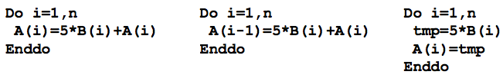
Example: Loop Parallelization
Which of the following loops are parallelizable?

Slide 17
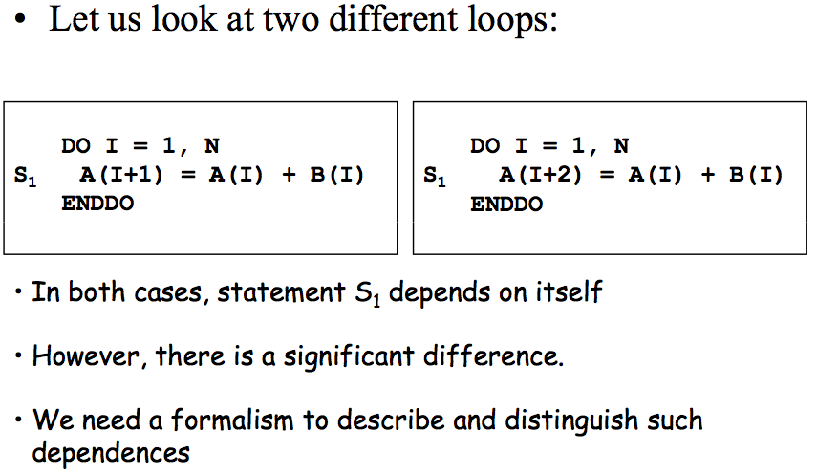
Dependence in Loops
1: A(2) = A(1) + B(1)
2: A(3) = A(2) + B (2)
3: A(4) = A(3) + B(3)
S1 &S1
1: A(3) = A(1) + B(1)
2: A(4) = A(2) + B(2)
3: A(5) = A(3) +B(3)
4: A(6) = A(4) + B(4)

Slide 18
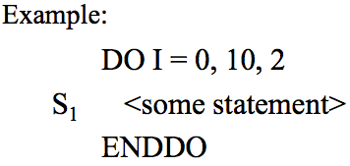
Iteration Numbers
The iteration number of a loop is equal to the value of the loop index
Definition:
For an arbitrary loop in which the loop index I runs from L to U in steps of S, the iteration number i of a specific iteration is equal to the index value I on that iteration:

Slide 19
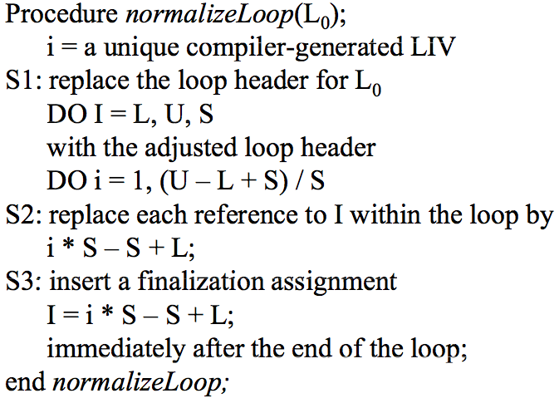
Algorithm: Normalizing Loops

Slide 20
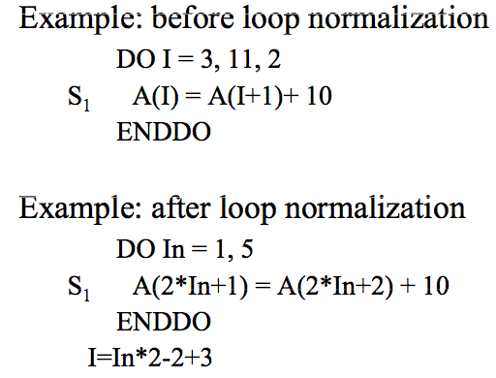
Normalizing Loops: Examples

Slide 21
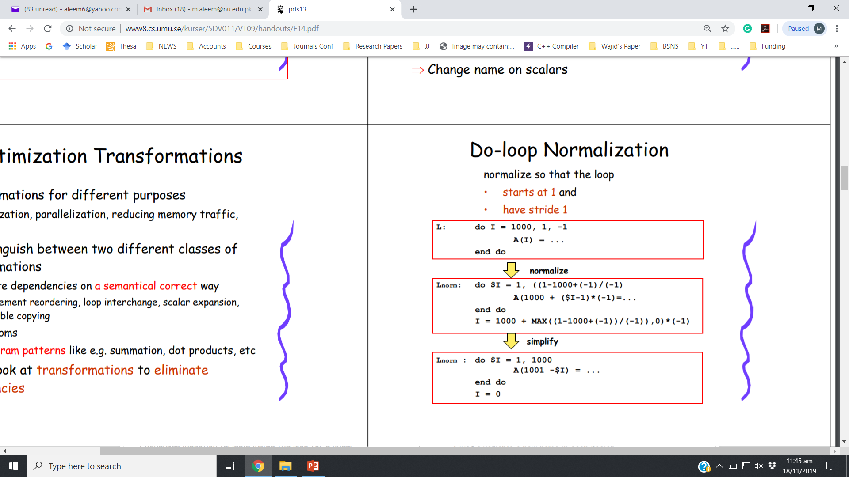
Normalizing Loops: Examples
Notes:
1-1000

Slide 22
Normalizing Loops: Examples

Slide 23
Normalized Iteration Space
DO I = 100, 20, -10 A(I) = B(100-I) + C(I/5) ENDDO
DO i = 1, 9 A(110-10*i) = B(10*i-10)+ C(22-2*i) ENDDO

Slide 24
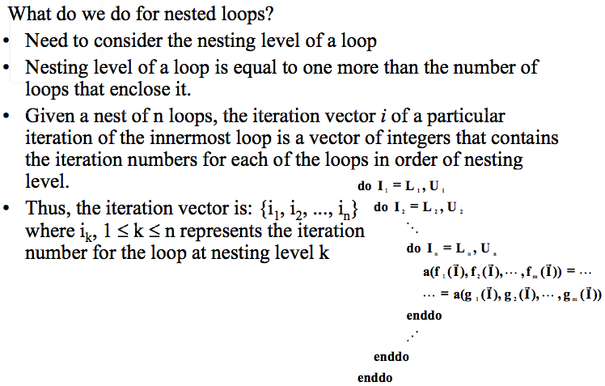
Iteration Vectors
Nesting level 1
Nesting level 2

Slide 25
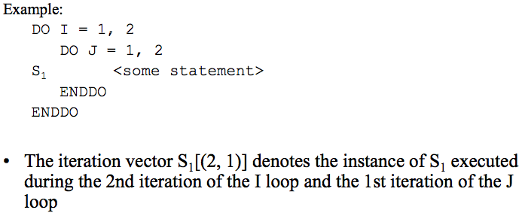
Iteration Vectors - Example

Slide 26
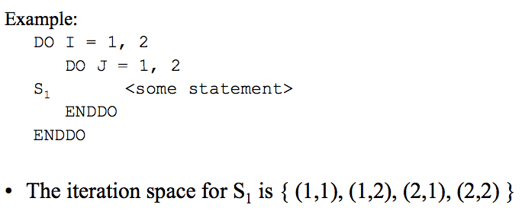
Iteration Space
Iteration Space: The set of all possible iteration vectors for a statement.

Slide 27
Ordering of iteration vectors
• Useful to define an ordering for iteration vectors
• i is a vector and i_{k} is the k-th element of i and i[1:k] is a k-vector consisting of the leftmost k elements of i
Define an order
Iteration i precedes iteration j, denoted i < j, iff:

Slide 28
Formal Definition: Loop Dependence
Theorem: Loop Dependence
• There exists a dependence from statements S1 to statement S2 in a common nest of loops if and only if there exist two iteration vectors i and j for the nest, such that:
i < j or i = j and there is a path from S1 to S2 in the body of the loop,
statement S1 accesses memory location M on iteration i and statement S2 accesses location M on iteration j, and
one of these accesses is a write

Slide 29
Transformations
• We call a transformation safe if the transformed program has the same "meaning" as the original program
• But, what is the "meaning" of a program?
“Meaning” of a program:
• Two computations are equivalent if, on the same inputs they produce the same outputs in the same order.
• Of course the performance of the program may change!

Slide 30
Re-Ordering Transformations
• A reordering transformation is any program transformation that merely changes the order of execution of the code, without adding or deleting any executions of any statements.
• A reordering transformation does not eliminate dependences.
• However, it can change the ordering of the dependence:
• e.g. change from true → anti-dependence or vice versa

Slide 31
Re-Ordering Transformations
• A reordering transformation preserves a dependence if it preserves the relative execution order of the source and sink of that dependence.
• Reordering transformations changing the control flow can be applied to improve the code unless any dependence is violated.

Slide 32
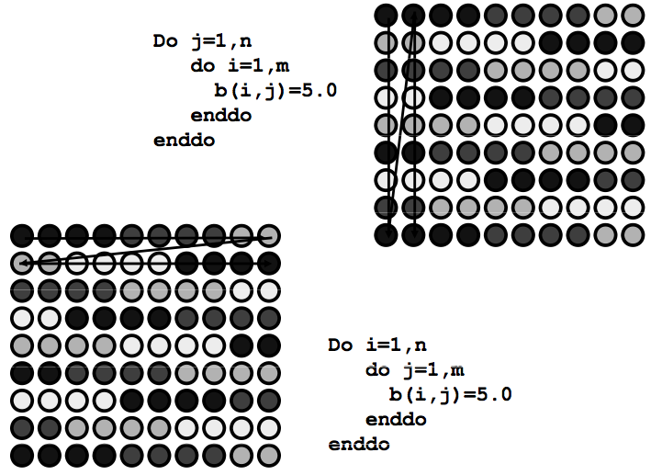
Example: Improving Data Locality

Slide 33
Fundamental Theorem of Dependence
• Fundamental Theorem of Dependence:
Any reordering transformation that preserves every dependence in a program preserves the meaning of that program
A transformation is said to be valid for the program to which it applies if it preserves all dependences in the program.
A valid transformation preserves the order of loads and stores to every memory location in the program – only input accesses can be reordered.

Slide 34
Distance Vectors
Distance vectors describe dependences among iterations.
A dependence is loop carried or independent is crucial to determine --> a loop can be executed in parallel or not?
They are important to reason about dependences inside of loops.
Consider a dependence in a loop nest of n loops
S₂ depends on S₁:
– Statement S1 on iteration i is the source of the dependence
– Statement S2 on iteration j is the sink of the dependence
Notes:
Source and Sink are two properties related to iterations not the array values.
Iteration I comes before iteration j

Slide 35

Distance Vectors
The distance vector d(i, j) is a vector of length n such that:
We shall normalize distance vectors for loops in which the index step size is not equal to 1.
Note that distance vectors describe dependences among iterations not among array elements.

Slide 36
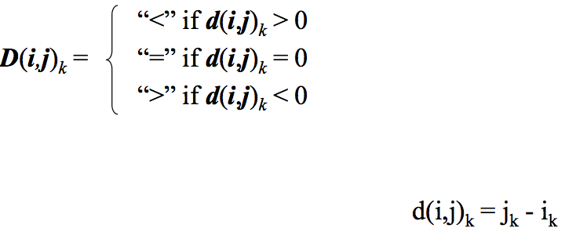
Direction Vectors
Suppose that there is a dependence from statement S1 on iteration i of a loop nest of n loops and statement S2 on iteration j, then the dependence direction vector D(i,j) is defined as a vector of length n such that:

Slide 37
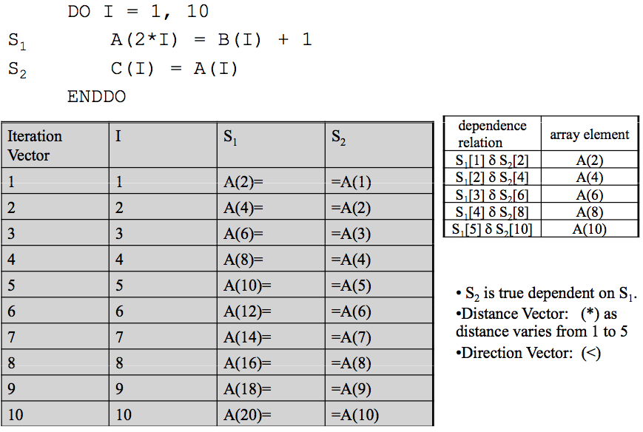
Direction Vectors – Example1

Slide 38
Direction Vectors – Example1

Slide 39
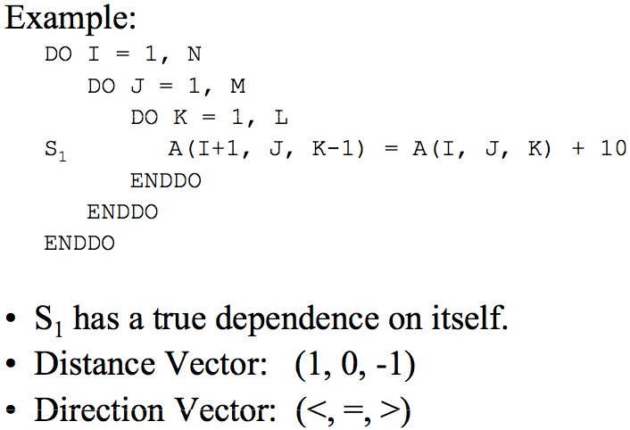
Direction Vectors – Example2

Slide 40
Direction Vectors – Example2
TWO Sample Iterations:
Source Iteration I=2, J=2, K=2 accesses the data item A(3,2,1)
Sink iteration I=3, J=2, K=1 accesses the data item A(3,2,1)
Sink-Source = (3,2,1) – (2,2,2) = (1,0,-1)

Slide 41
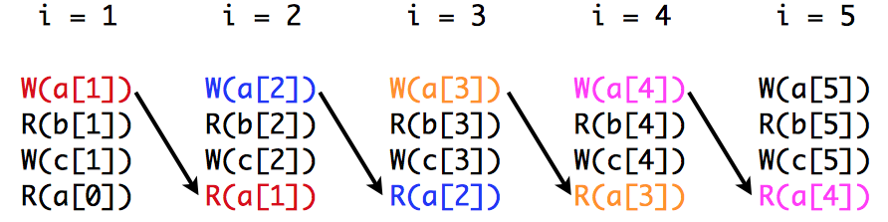
Source and Sink of Dependence
Dependence source is the earlier statement (the statement at the tail of the dependence arrow)
Dependence sink is the later statement (the statement at the head of the dependence arrow)
Dependences can only go forward in time: always from an earlier iteration to a later iteration.

Slide 42
Direction Vectors
A dependence cannot exist if it has a direction vector whose leftmost non "=" component is not "<"
As this would imply that the sink of the dependence occurs before the source (which is not true)
How many dependences are there between a pair of statements in a loop nest?
One dependence for every statement instance that is the source of a dependence to another statement instance in the same loop nest.
Compiler collect only the different direction vectors for every different pair of statements.

Slide 43
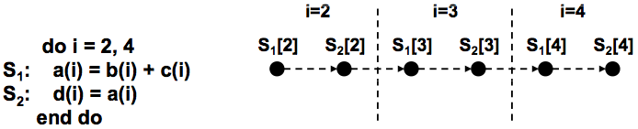
Example-1

Slide 44
Example-1
There is an instance of S1 that precedes an instance of S2 in execution, and S1 produces data that S2 consumes.
S1 is the source of the dependence; S2 is the sink of the dependence.
The dependence flows between instances of statements in the same iteration (loop-independent dependence).
The number of iterations between source and sink (dependence distance) is 0. Dependence direction is ( = ).

Slide 45
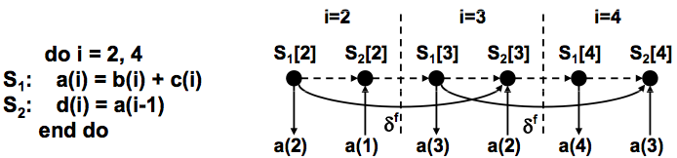
Example-2
There is an instance of S1 that precedes an instance of S2 in execution, and S1 produces data that S2 consumes.
S1 is the source of the dependence; S2 is the sink of the dependence.
The dependence flows between iterations (loop-carried dependence).
The number of iterations between source and sink (dependence distance) is 1. Dependence direction is ( < ).
Notes:
TRUE DEPENDENCE

Slide 46
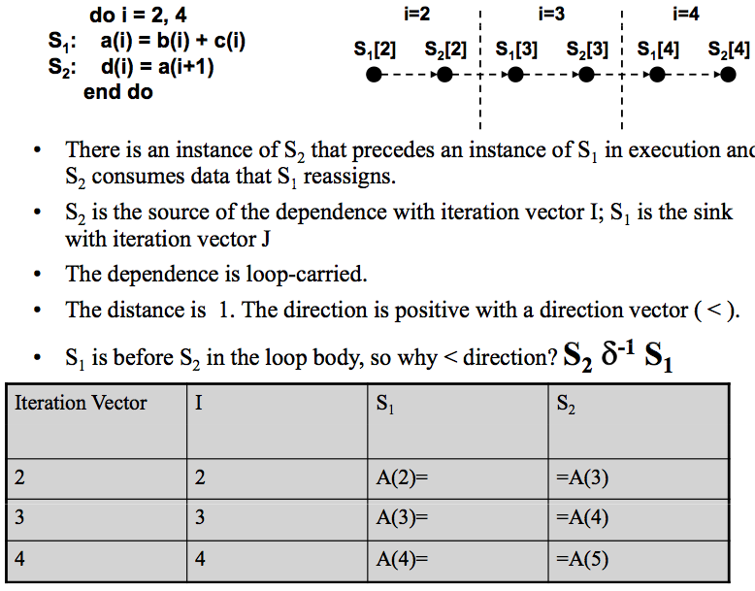
Example-3
Notes:
Because S2 is source and S1 is sink therefore:
ANTI DEPENDENCE
Distance 1, == SINK iteration- SOURCE Iteration == 3-2 == 1

Slide 47
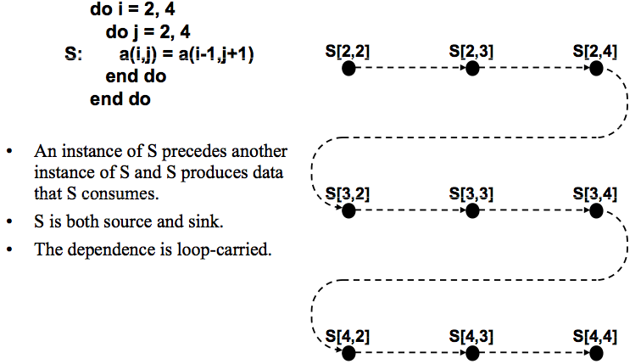
Example-4
Notes:
S(2,2) = S(1,3)
S(2,3) = S(1,4)
S(2,4) = S(1,5)
S(3,2) = S(2,3)
Sink- Source
(3,2) – (2,3) = 1,-1 → <,>

Slide 48
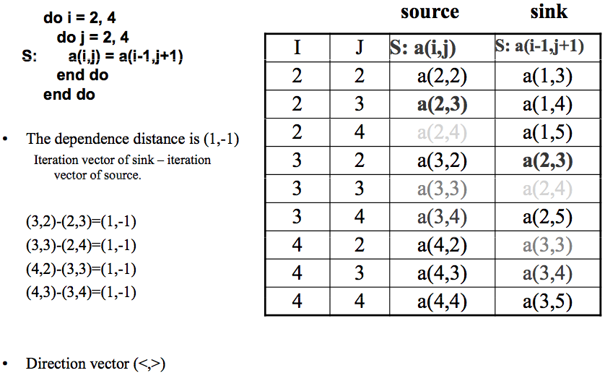
Example-4 continued…

Slide 49
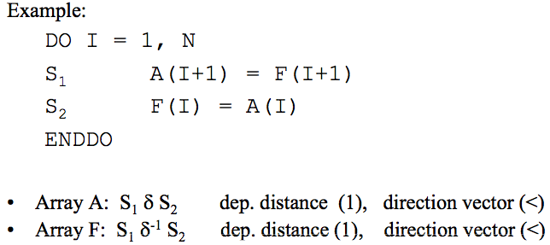
Loop Carried Dependence
Statement S2 has a loop-carried dependence on statement S1, if and only if S1 references location M on iteration i, S2 references M on iteration j and d(i,j) > 0 (that is, D(i,j) contains a “<” as leftmost non “=” component).

Slide 50
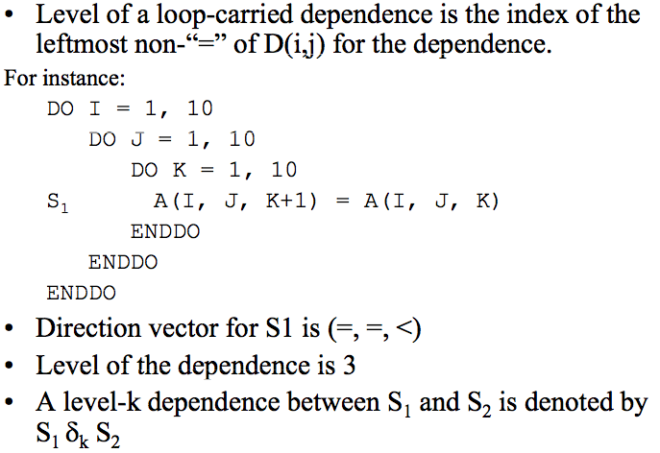
Loop Carried Dependence

Slide 51
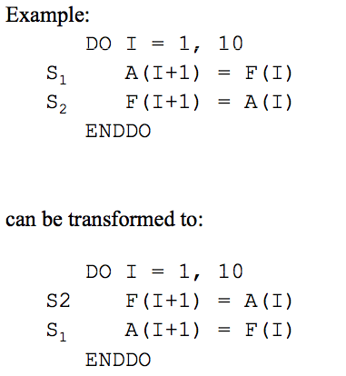
Loop Carried Transformations
Can be transformed or Not?
Will the dependencies be retained or inverted?
Notes:
By transforming the true dependences for array elements A and F remains as true dependence in the transformed loop

Slide 52
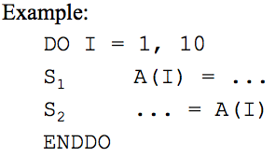
Loop-Independent Dependence
Definition: Statement S2 has a loop-independent dependence on statement S1, if and only if there exist two iteration vectors i and j such that:
Statement S1 refers to memory location M on iteration i, S2 refers to M on iteration j, and i == j
There is a control flow path from S1 to S2 within the iteration.

Slide 53
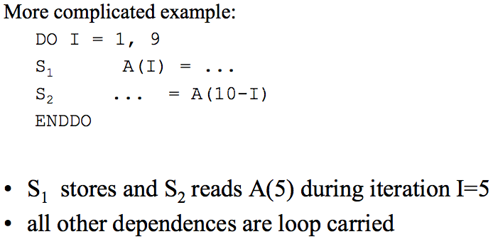
Loop-Independent Dependence

Slide 54
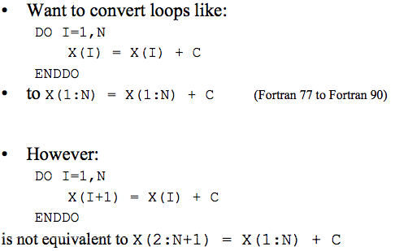
Parallelization and Vectorization
Theorem: it is valid to convert a sequential loop to a parallel loop if the loop carries no dependence.

Slide 55
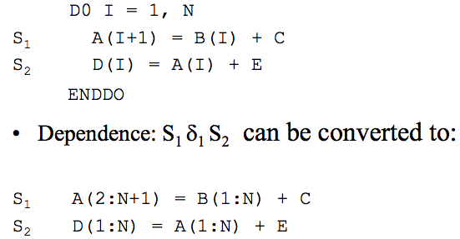
Loop Distribution
Can statements in loops which carry dependences be vectorized?
Notes:
We can split the loop and then parallelize each one separately (No violation of loads and stores). So after transformation we can vectorized the loops

Slide 56
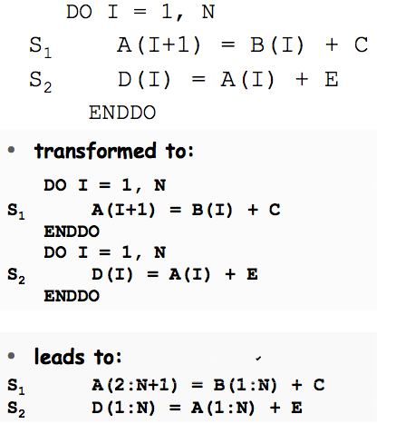
Loop Distribution – Example2
Notes:
True Dependence is Borken/Resolved.

Slide 57
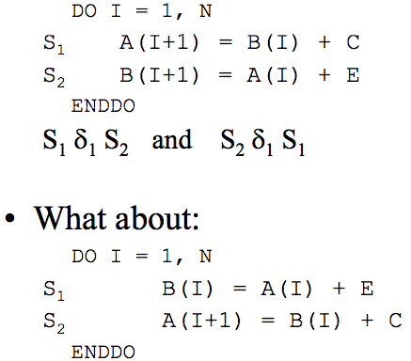
Loop Distribution
Loop distribution fails if there is a cyclic dependence
Loop can be distributed → only 1 loop carried dependence
Notes:
Second loop can be vectorized because it has only one loop carried dependence, other dependence (B(I) → B(I)) is not loop carried

Slide 58

Dependence Testing Complications
- Un-known Loop bounds:
What is the relationship between N and 10?
If N<=10 → No loop carried dependence
If N>10 → loop carried dependences
Notes:
If the loop iterates up to 10 (i.e., i==10) → There will be no loop carried dependence
However, if I iterates up to 20, then There will be loop carried dependences

Slide 59
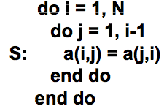
Dependence Testing Complications
- Triangular loops:
for (j = 0; j < height; j++) {
for (i = 0; i <= j; i++) {
printf("*");
}
printf("\n");
}
Example run:
height of triangle: 6
*
**
***
****
*****
******
Notes:
In a triangular loop, the number of iterations the inner loop executes depends on the value of the outer loop's loop variable
Must impose j < i as an additional constraint

Slide 60
Dependence Testing Complications
i → 1 to 3
J → 1 to 2
i | j | A (I,j) | A(j,1)
1 | 1 | A(1,1) | A(1,1)
1 | 2 | A(1,2) | A(2,1)
2 | 1 | A(2,1) | A(1,2)
2 | 2 | A(2,2) | A(2,2)
3 | 1 | A(3,1) | A(1,3)
3 | 2 | A(3,2) | A(2,1)

Slide 61

Dependence Testing Complications
- User Variables:
- Serious Problem: Aliases/Pointers

Slide 62
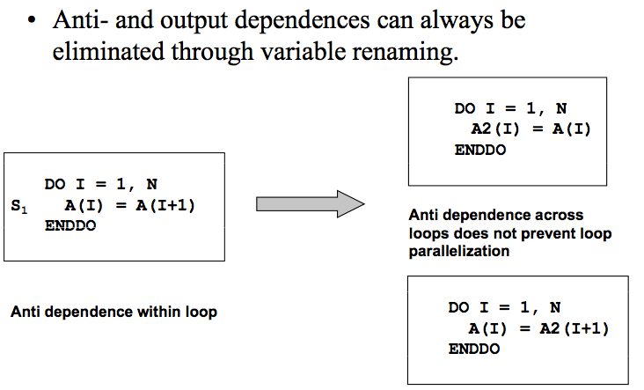
Eliminating Anti and Output Dependence

Slide 63
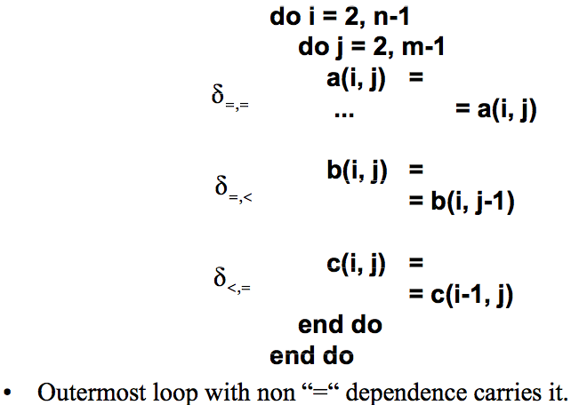
Loop Parallelization
A dependence is said to be carried by a loop, if the loop is the outermost loop whose removal eliminates the dependence.
- If a dependence is not carried by the loop, it is loop-independent.

Slide 64
Loop Parallelization
The iterations of a loop may be executed in parallel with one another if and only if NO dependences are carried by the loop!

Slide 65
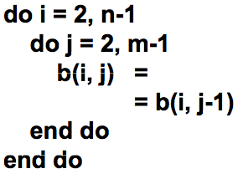
Loop Parallelization Example-1
• Iterations of loop j must be executed sequentially, but the iterations of loop i may be executed in parallel.
• Outer loop parallelism.

Slide 66
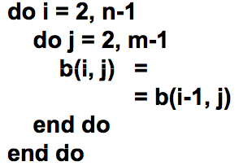
Loop Parallelization Example-2
• Iterations of loop i must be executed sequentially, but the iterations of loop j may be executed in parallel.
• Inner-loop parallelism.

Slide 67
Techniques for Breaking Dependencies and for Dealing with Scalars
Privatization
remove dependencies created by use of temporary workspaces
Induction Variable Substitution
find closed solutions for basic induction variables
Reduction
Use reductions as compared to own-implemented code etc.
Notes:
In computer science, an induction variable is a variable that gets increased or decreased by a fixed amount on every iteration of a loop, or is a linear function of another induction variable.
For example, in the following loop, i and j are induction variables:
for (i = 0; i < 10; ++i) {
j = 17 * i;
}

Slide 68
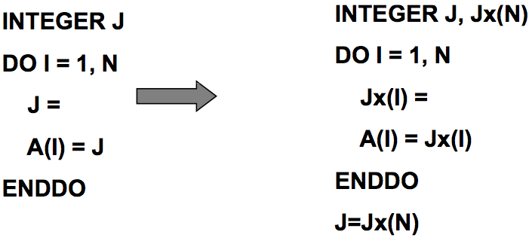
Privatization or Scalar Expansion
All scalar assignments will cause loop-carried dependencies
Can create local per-iteration or (more practically) per thread copies
– scalar expansion or privatization

Slide 69
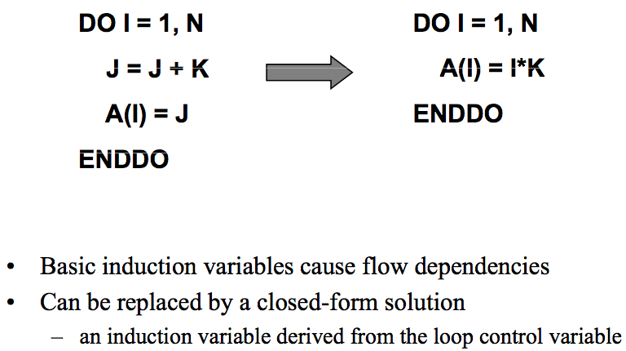
Induction Variable Substitution
Notes:
In computer science, an induction variable is a variable that gets increased or decreased by a fixed amount on every iteration of a loop

Slide 70
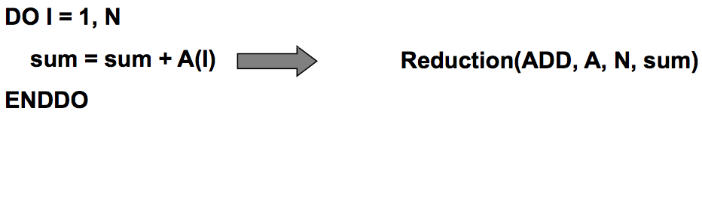
Reduction
Notes:
P number of local sums
Then P1+P2+…Pi will be still a sequential operation

Slide 71
Any Questions

